Slide 1
Resume Entity Extraction
Problem and solution

Slide 2

What is the overall task
Understand what the owner of the resume offers
Classify different aspects of what the resume offers
Create a timeline of the events that the person has worked in
Vdart Inc
Manager
2019 – 2020
This requires to create a link between objects
Semi Structed Documents*

Slide 3
What we are doing
OCR
(Vision)
Document
Entity
Extraction
Txt String
List of extracted entities
Labels
PROS
CONS
Lose all the meta data of the location of where the data is located
Low probability → not working best
Un able to link/understand entities
Picks out important information like skills
Mark important words

Slide 4
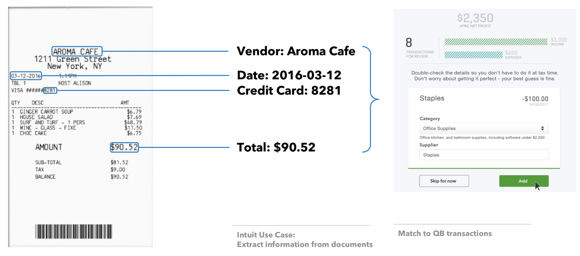
Goal

Slide 5
Solution
Mulitple Choices

Slide 6
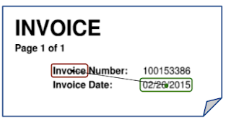
OCR
Using Vision API split the document
JSON, block splitter
Use naïve baize classifier to check between extracted entities and location of it in the document.
Using the splitter, better understand the document and create a timeline out of pure programming and algorithms
Will be using DocumentAI in this situation
Understanding the bold/size/color of text to better understand

Slide 7
CV OCR Entity Document Understanding
Create a CV model (from scratch) that will be able to link entities together in a hierarchy
Need mulitple data scientists and engineers
Attempt to create model using open source options that are available
Nanonets
IBM
Other medium articles
Doesn’t have to be perfect because if linked with others, could be extremely helpful

Slide 8
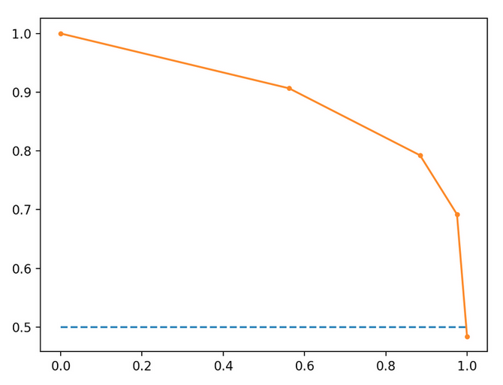
Recall/Precision Curve
Varies on what the user is looking for in their output
Only 1 entity extracted → 100 percent accuracy
Barely any entities will be detected
Almost always the label will be correct
Every entity detected → low percent accuracy
Some of the entities labels will be wrong
All entities will be detected
Need to understand a balance between it and what exactly our task requires

Slide 9
Entities
Name
Kunal
Aneja
Education
Name
Alpharetta High School
Start Date
2017
End Date
2020
Other
{…}
KUNAL ANEJA
Education:
2017 - 2020
Alpharetta High School
2015- 2017
Webb Bridge Middle School
Using this process we can create a much better structed format of the data which is much easier to understand and return
Much higher accuracy
Create timeline out of data

Slide 10
Problems
When we get a list of skills and all of their meta data how do we get a understanding of them
How do we understand their level for that skll

Slide 11
Future Steps
Subject to Future Changes

Slide 12
Tasks
Create data for entity extraction → $
Set up DocumentAI → Classify Document
Set up/program/create data for label classification on GCP
Program LinkedIn and GitHub API
Program Vision API to split documents
Setup AWS for entity extraction on split documents
BUILD OCR CV MODEL FOR DOCUMENT ENTITY EXTRACTION
Bring all data together for final report and run full tests
Test out information from articles, and expand into different options

Slide 13
Links
https://medium.com/intuit-engineering/building-a-financial-document-understanding-platform-9e42f7d497c
https://www.skillate.com/blog/smart-recruitment-cracking-resume-parsing-through-deep-learning-part-i/
https://ai.googleblog.com/2020/06/extracting-structured-data-from.html
https://storage.googleapis.com/pub-tools-public-publication-data/pdf/59f3bb33216eae711b36f3d8b3ee3cc67058803f.pdf
https://nanonets.com/blog/ocr-financial-documents/
https://nanonets.com/blog/receipt-ocr/

Slide 14
Process to follow for IBM watson
https://developer.ibm.com/technologies/artificial-intelligence/patterns/image-recognition-and-information-extraction-from-image-documents-using-keras-and-watson-nlu/

Slide 15
Vision API Test Link
https://cloud.google.com/vision/?utm_source=google&utm_medium=cpc&utm_campaign=na-US-all-en-dr-bkws-all-all-trial-e-dr-1009135&utm_content=text-ad-none-any-DEV_c-CRE_291249276637-ADGP_Hybrid%20%7C%20AW%20SEM%20%7C%20BKWS%20%7C%20US%20%7C%20en%20%7C%20EXA%20~%20ML%2FAI%20~%20Vision%20API%20~%20Google%20Vision%20Api-KWID_43700036257547159-kwd-475108782609&utm_term=KW_google%20vision%20api-ST_Google%20Vision%20Api&gclid=CjwKCAjwkJj6BRA-EiwA0ZVPVj90TMpGcdfWGVJTprUrcKCQAZ7wQLxtZO1jLNeFW_cQJBZS51OKKBoCDQYQAvD_BwE&authuser=0#industry-leading-accuracy-for-image-understanding

